Slide 1


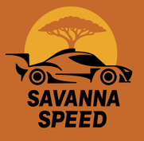
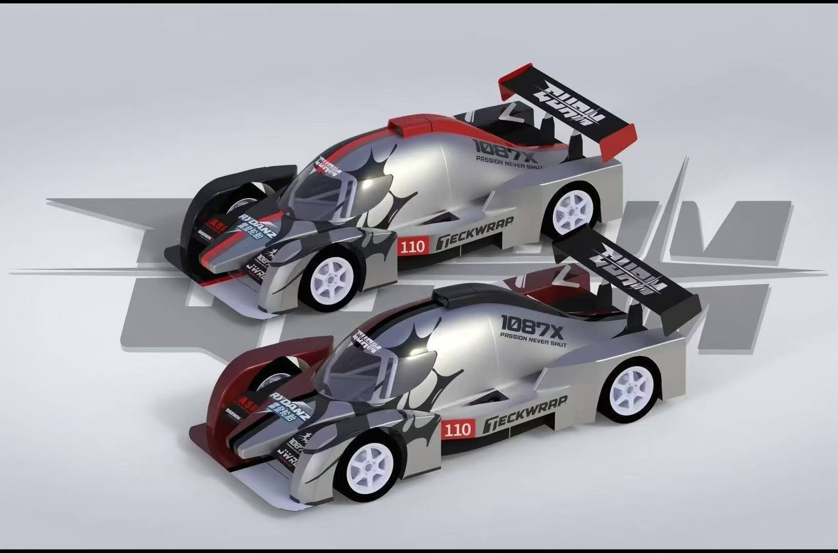
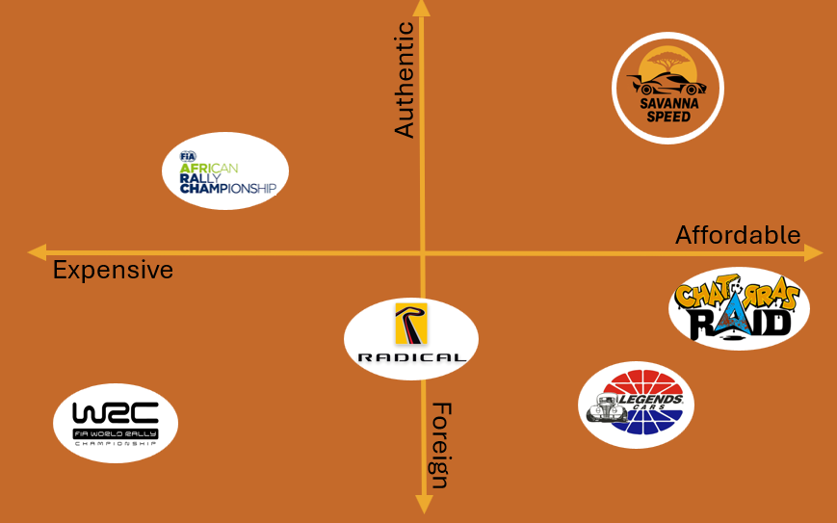
WHAT WE OFFER
Zambia as Africa’s Motorsport Hub: We aim to position Zambia as the heart of African motorsport, combining local identity, innovation and sustainability.
Racetrack construction and Championship: We want to build the first Zambian circuit and bring a unique two-tier format with open community racing and professional competitions.
Accessible and Inclusive Motorsport: We aim to expand motorsport horizons across Sub-Saharan-Africa, opening the track to everyone with low-cost entry programs and equal opportunities for all drivers.
Innovation and Technology Development: We design and build a cutting-edge race car prototype at low cost, leveraging new technologies to train talent and build the future of technological development of Africa.
Commercial and Media Growth: We want to expand the Sub-Saharan African motorsport ecosystem through TV rights, sponsorships and strategic partnerships.
HOW WE MAKE MONEY
Diversified Revenue Model: Income comes from racing activity, media exposure and strategic commercial partnerships.
Championship and Hot-Lap Fees: We monetise track usage through professional race weekends and daily Hot-Lap sessions, creating consistent and scalable revenue.
Symbolic Ticketing: Ticket prices are intentionally low to maximise attendance, strengthen community engagement and increase the value of sponsorships and TV rights.
Sponsorships and Partnerships: Local and international brands support the project through annual sponsorship deals and commercial activations, forming a major revenue pillar.
Broadcasting and Media Rights: High attendance and unique race formats help secure TV and streaming agreements across Sub-Saharan Africa.
Simulators: Additional income comes from simulators and training sessions.
THE CAR
We aim to build a high-performance race prototype with low cost and low environmental impact. It features:
THE RACETRACK
With the support of the Zambian government, we will build the country’s first permanent racing circuit as a national development project. Our contribution focuses on the essential operational facilities: garages, paddock units and technical buildings, designed for low-cost construction and efficient maintenance. This shared infrastructure model gives us access to a professional-grade racetrack while keeping investment requirements low. In this way, we help lay the foundation for a sustainable motorsport ecosystem that can grow and benefit the entire region.
Closed-wheel bodywork
Simple tubular frame
Plastic aero appendices
Recycled motorbike engine and gearbox
Single seat variation for racing
Double seat variation for training
This approach allows us to make motorsport more accessible while still delivering a reliable and engaging racing experience.
OUR REACH AND SCALE
Our first-mover advantage, the identity we build within the territory, together with the economic and technological development our product brings and the support of local government, represent key factors that ensure the success of our business. We are the only providers of a complete motorsport experience in sub-Saharan Africa, making us the sole players capable of serving the vast and growing market of motorsport enthusiasts across the continent. Our headquarter is in Lusaka, the financial and legal hub of the country and its most densely populated region, ensuring the best possible strategic position for our operations. We cater to a broad range of social groups by offering diverse service levels and experiences at different price points, ensuring that everyone can feel included in the project. Our target audience includes professional and aspiring drivers, middle- to upper-income individuals, and motorsport fans with limited budgets who still want to enjoy the excitement of a race weekend.
HOW WE SET OURSELVES APART
Rooted in community development, inclusivity and local identity.
Accessible for professionals and first-time drivers
Symbolic ticketing
Low-cost participation
A cultural and social platform rather than an exclusive sport
Authentic and Affordable are our key features!
Our approach strengthens local engagement, attracts new talent, supports regional economic growth and gives Zambia ownership over its own motorsport ecosystem, making the community not just spectators, but true protagonists of the project. Ultimately, our vision is to create a long-lasting legacy that empowers future generations and transforms motorsport into a driver for positive social change.
INVESTMENT ASK
We are raising £10 million to launch our business. Most of the investment will be allocated to the design and construction of the racetrack facilities, while the remaining funds will be divided among car development and production, marketing and communication activities, and human resources. In addition, part of the investment will cover operational costs during the first years of activity, ensuring a stable foundation until the business becomes profitable. The expected return on investment for investors is 7.56% after five years of operation.

